Slide 1
Univariate

Slide 2
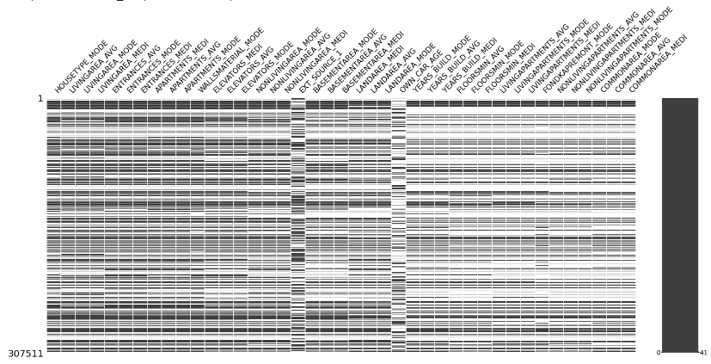
On the x-axis we have “SK_ID_CURR” and y-axis we have all the features with more than 50% of nan values.
It is very significant that the nan values are evenly distributed.

Slide 3
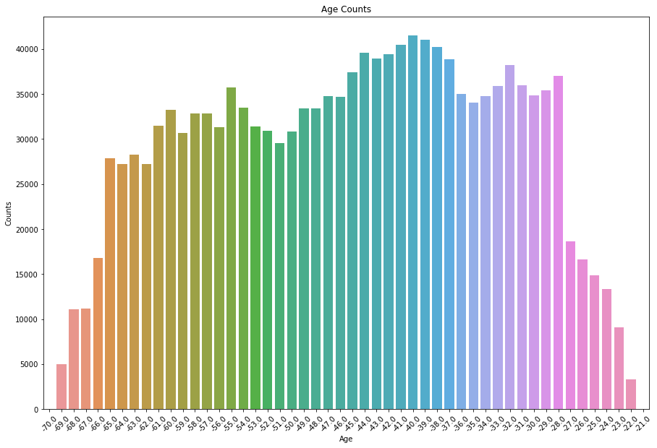
Age Count

Slide 4
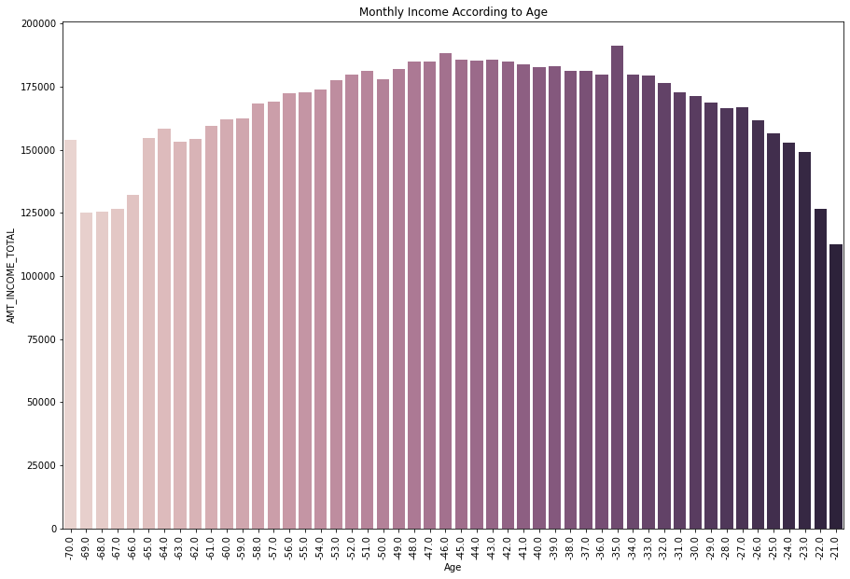
Age w.r.t Income

Slide 5
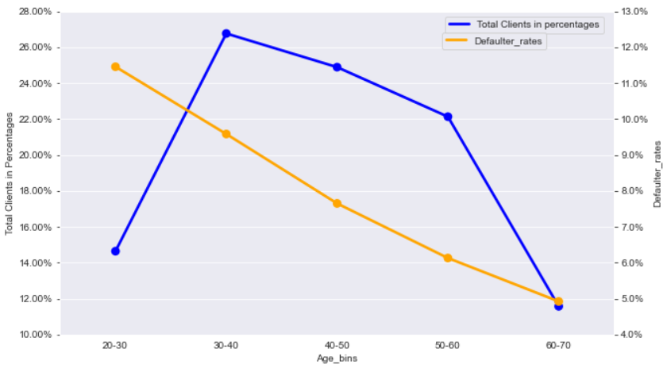
Age Distribution w.r.t Target
27% of our clients are aged 30-40 with a risk of 9.5%.
Age group 40-50 don't have the highest number of clients but still has pretty a high no of clients and has a significantly lower default rate at around 7.6%.
Similarly Age group 50-60 has a high number of clients but relatively lower default rate at 6%.
So, we can say that age groups 30-40 and 40-50 are most profitable.

Slide 6
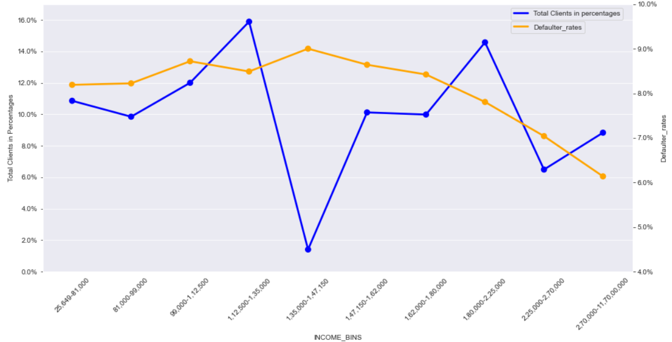
Income Type Defaulter Rates
16% of our clients have an income of 1,12,000-1,35,000 with a high defaulter rate of 8.5%.
Whereas, we have slightly lower number of clients with an income of 1,80,000-2,25,000 but they have comparatively lower defaulter rate at 7.8%.
8.8% of our clients have an income of 2,70,000-11,70,00,000 but have a very low defaulter rate at 6.1%

Slide 7
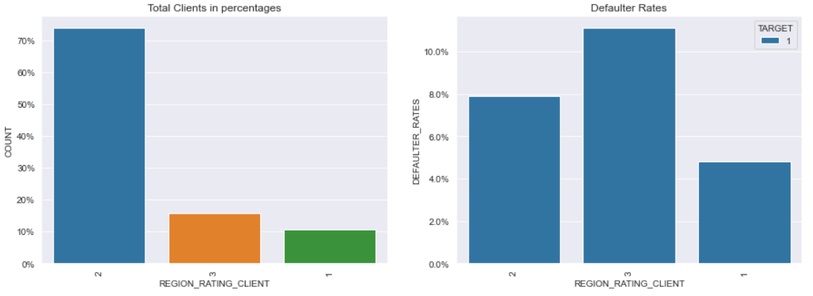
Ratings for Region where Client lives
Highest number of our clients are from Regions with rating 2 at 74% but they have a lower default rate at 7,8%.
We have a lower number of clients from regions with rating 3 but their default rate is lot higher at 11.1%.
10% of our clients are from regions with rating 1 and they have the lowest rate at 4.8%.

Slide 8
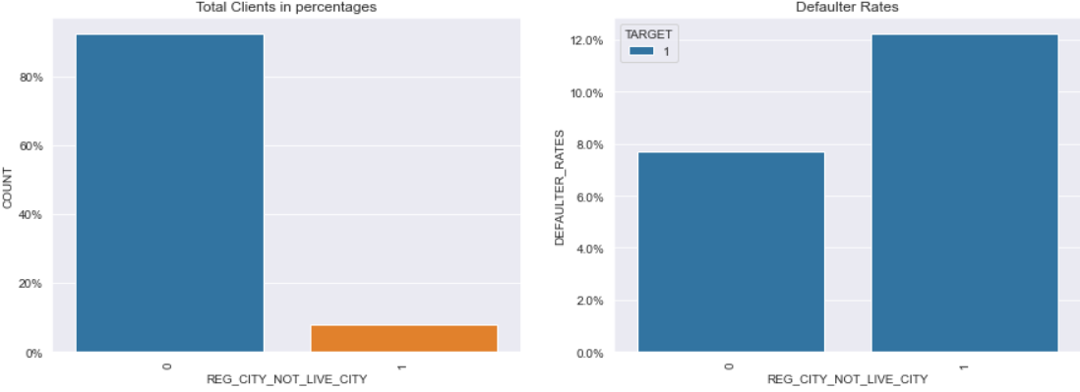
If Client’s Permanent address does not match Contact address(at city level)
0 is for if addresses are same, 1 is for if addresses are different.
92% of our clients have a same permanent city address and contact address but they have lower default rates at 7.7.%.
Although we have a lower number Clients with a different permanent address and contact address, their default rate is much higher at 12.3%.

Slide 9
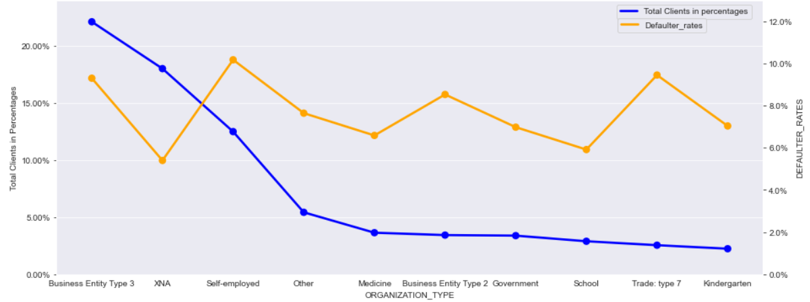
Organization Type
22% of our clients are from Business Entity Type 3 with a high defaulter rate at 9.3%.
XNA has slightly lower count of clients but the defaulter rate is comparatively a lot lower at 5.4%.
There are relatively lower number of clients who are Self Employed but have the highest default rate at 10.1%

Slide 10
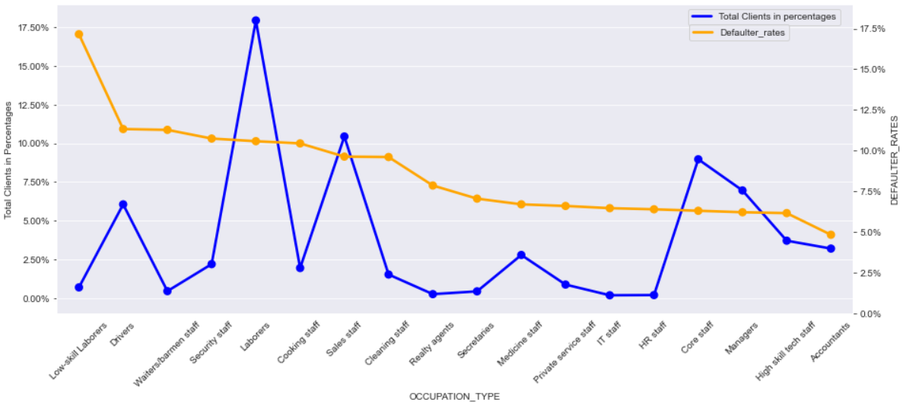
Top Occupation Type Defaulters
Around 18% of our clients are Laborers with a risk of 10.6%.

Slide 11
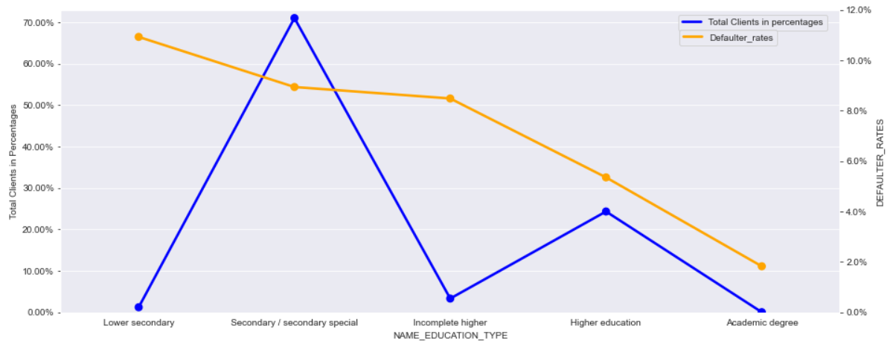
Education Type of the Clients
Even though we have lower number of clients from Incomplete higher at 3.3% , they have a high defaulter rate of 8.5%.
71% of our Clients are Secondary/ Secondary special graduates with a higher risk of 8.9%.
Clients with Higher Education are highly profitable as even though we have a higher number of clients with higher education as compared to Incomplete higher, their default rate is a lot lower.

Slide 12
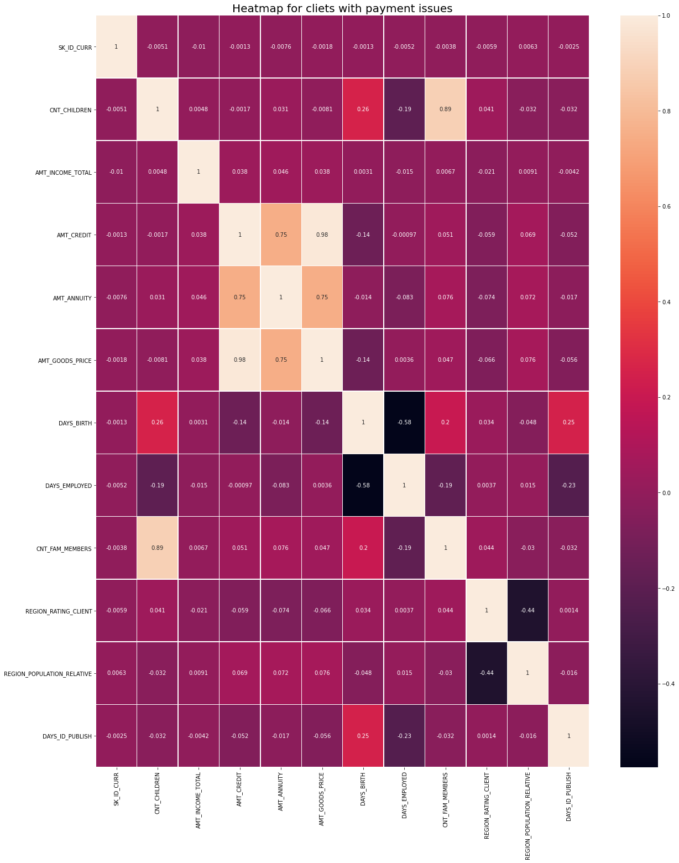
Clients with payment issues
Heatmap for customers with payment issues.

Slide 13
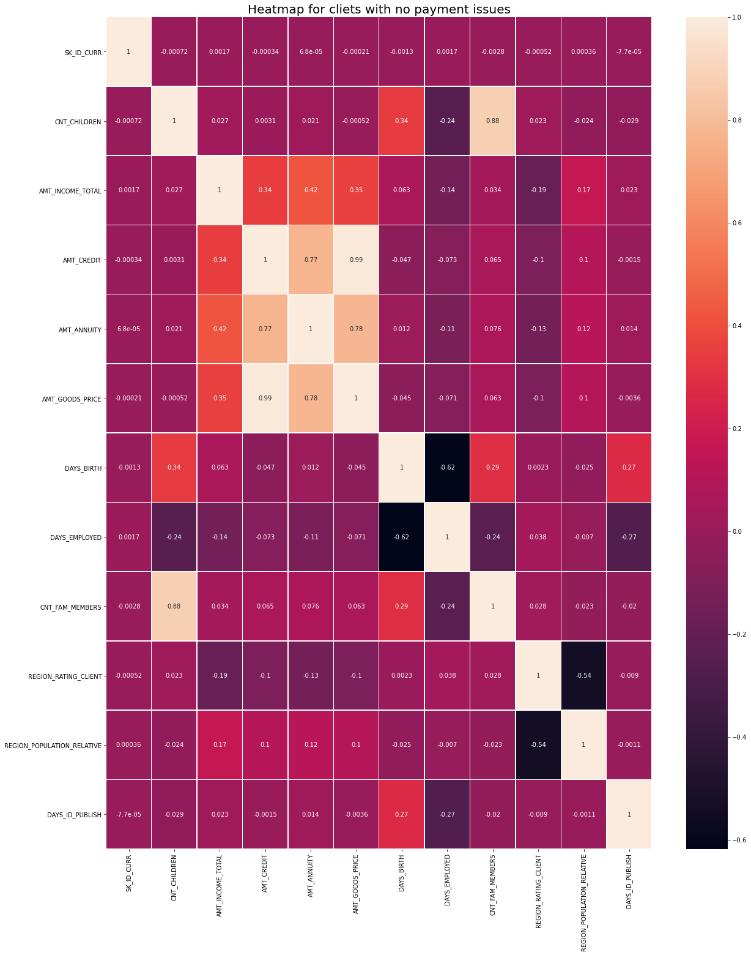
Clients with no payment issues
From the heatmaps we can conclude that
the features with high co relations
in both the cases i.e. customers paying back
the credit amount and customer not paying back
the credit amount are:
1: "AMT_GOODS_PRICE" and "AMT_CREDIT"
2: "AMT_ANNUITY" and "AMT_CREDIT"
3: "AMT_ANNUITY" and "AMT_GOODS_PRICE"
4: "CNT_FAM_MEMBERS" and "CNT_CHILDREN"
5:"AMT_ANNUITY" and "AMT_INCOME_TOTAL"
6: "AMT_INCOME_TOTAL" and "AMT_GOODS_PRICE”
for customers with no
payment issues.

Slide 14
Multivariate

Slide 15
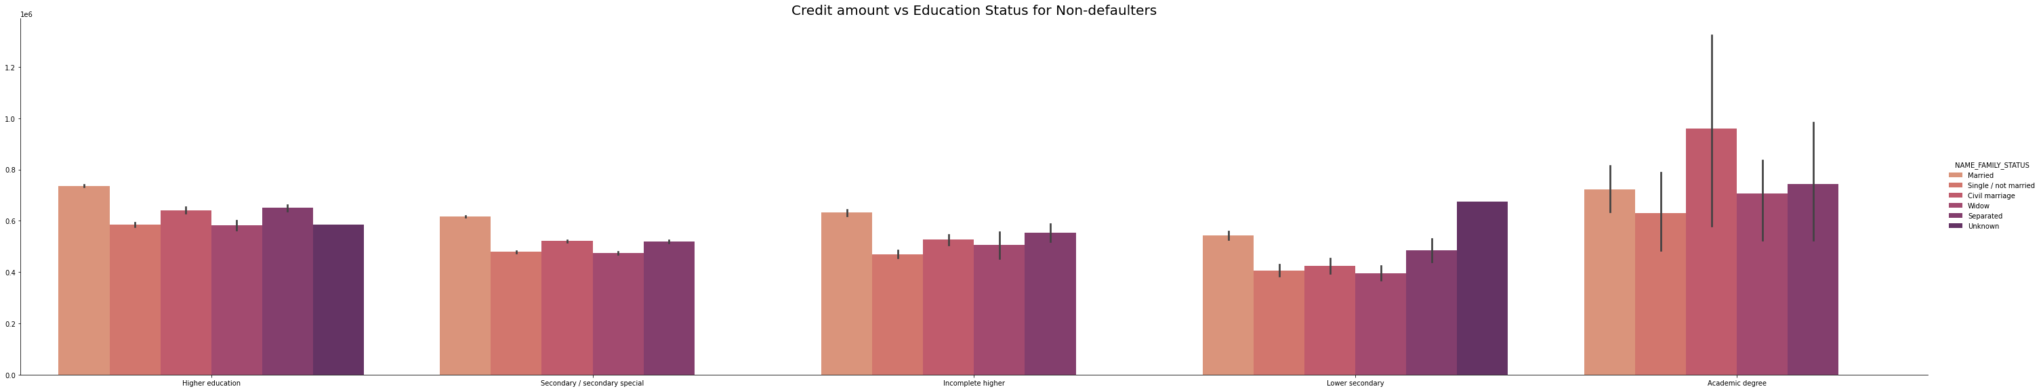
Credit Amount vs Education Status for Non Defaulters
Points to be concluded from the above graph for Non-Defaulters:
1: Customers holding academic degree have greater credit amount, Civil marriage applicants being the highest among them.
2: Applicants with Lower education tends to have lower credit amount, Widows being the lowest among them
3: Married customers in almost education segment except lower secondary and academic degrees have a higher credit amount.

Slide 16
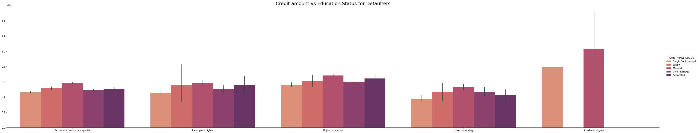
Credit Amount vs Education Status for Defaulters
Points to be concluded from the above graph for Defaulters:
1: Married Academic degree holding customers mostly have a high credit amount and so their defaulting rate is also high.
2: Education affects the credit amount. Across all education segment married customer tends to have higher credit amount Customers holding lower education tends to have a lower credit amount.

Slide 17
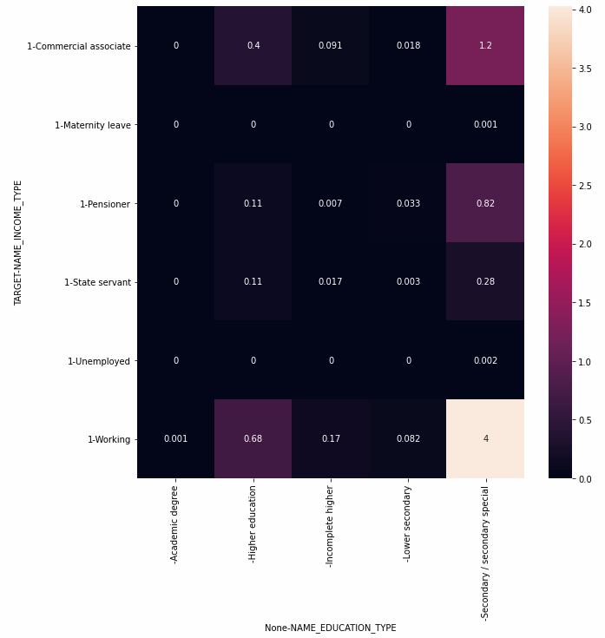
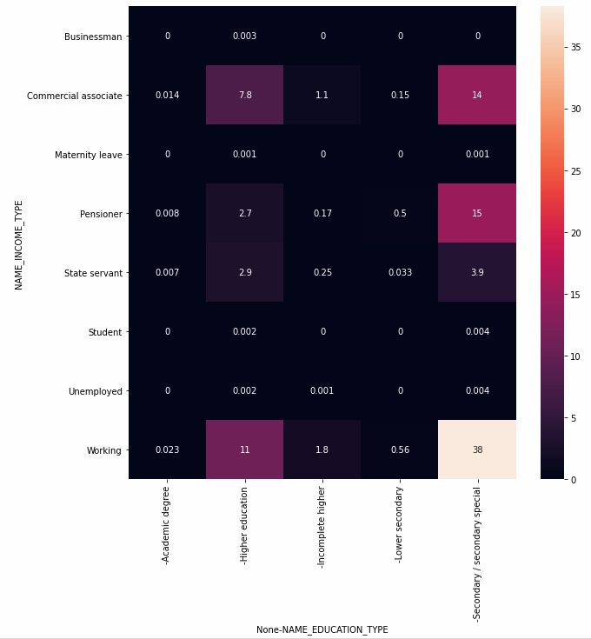
Target w.r.t income_type and education_type
Major percentage of client are working type with education as secondary special been high percentage we see high default percentage.

Slide 18
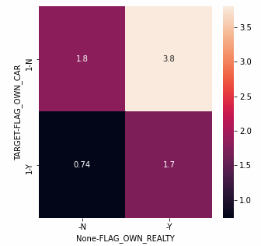
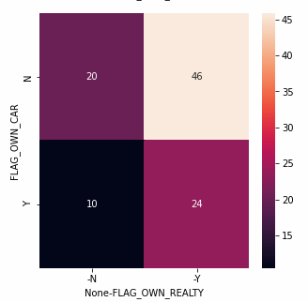
Target w.r.t own_car, own_house
Major part of our client own a house but not a car.

Slide 19
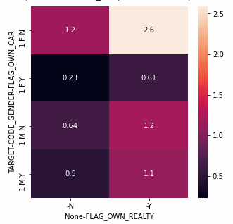
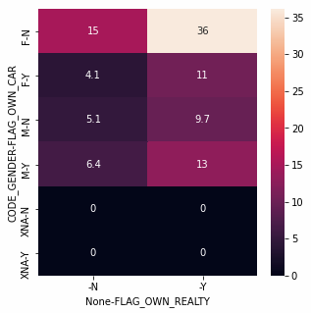
Target w.r.t own_car, own_house,gender
Very high percentage of female own a house but not a car.
Male percentage is significantly high for owning both car and house as compared to female.
HIgher the volume higher the default rate.

Slide 20
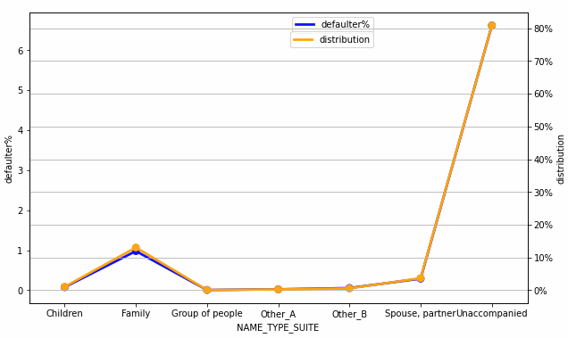
Target w.r.t NAME_TYPE_SUITE
Defaulter rate and proportion of data go hand in hand.
Let it be female or male for both we are able to see high for “Unaccompanied” as NAME_TYPE_SUITE .

Slide 21
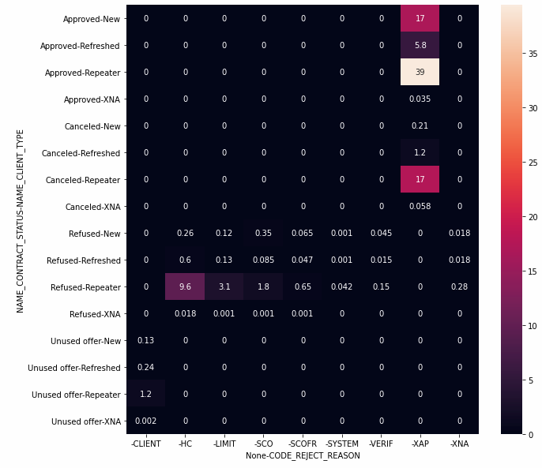
Name_contract_status, Client_type vs Code_rejection
The rejection for repeaters is majorly due to HC code i.e almost 9% followed by limit code with 3% and for approval XAP code plays important role for all client

Slide 22
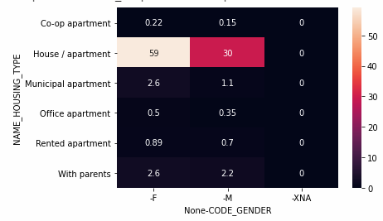
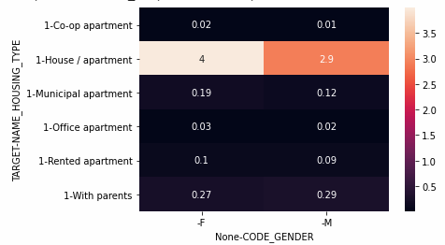
Target w.r.t Name_house_type vs code_gender
Larger proportion of our clients living in house/apartment. Being higher in percentage it is very likely to see higher default rate.
It is better to give loan to female over male who live in house/apartment

Slide 23
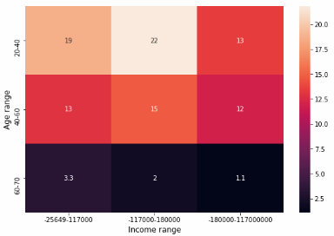
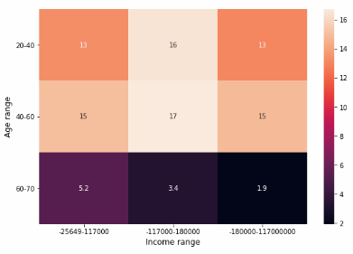
Target w.r.t Income range and Age range
The age between 20-40 with income range 25,700 to 117000 is of higher risk as they contribute 19% of default with respect to defaulter's data.

Slide 24
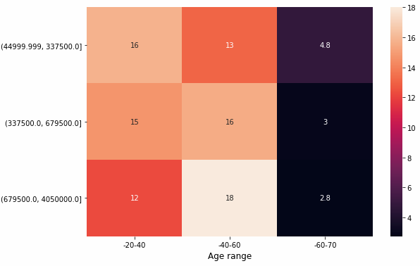
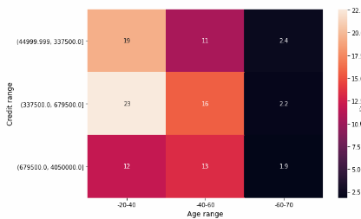
Age range vs credit range w.r.t target
Giving any amount of credit to people with age group between 60 to 70 will be good.
Credit of 338000 to 680000 with age between 20 to 40 is of risk as default rate is 23% holding 15% of distribution of overall data.

Slide 25
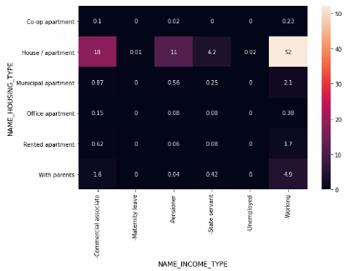
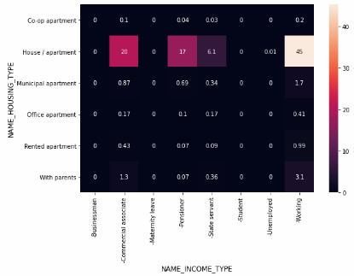
Target w.r.t Housing_type and Income_type.
Giving pensioner and commercial associate credit who lives in his own house/apartment would be good choose.
Giving credit to working class who lives in his own house is a risk.

Slide 26
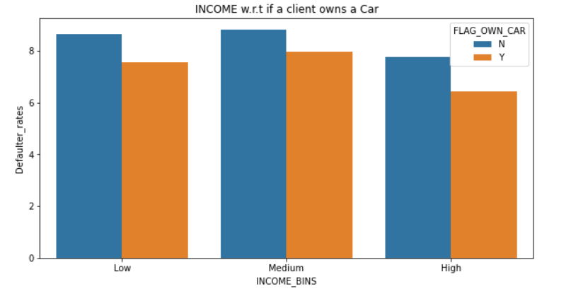
Client’s Income w.r.t if they own a Car
- Clients of all income group have a higher defaulter rate if they don’t own a car

Slide 27
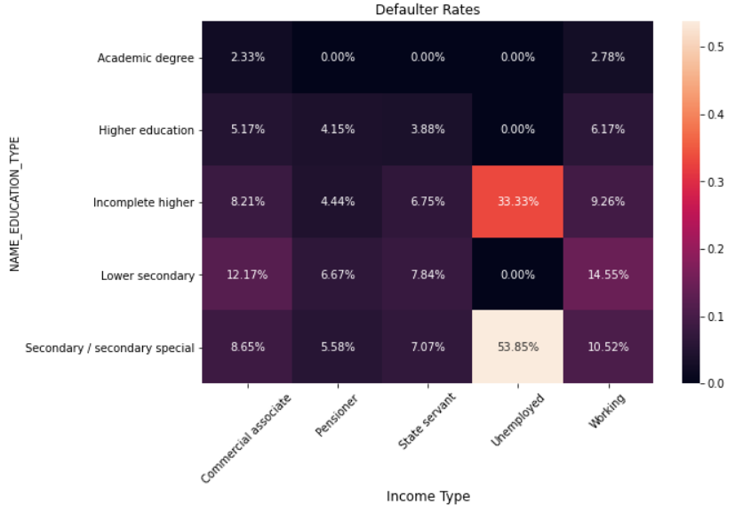
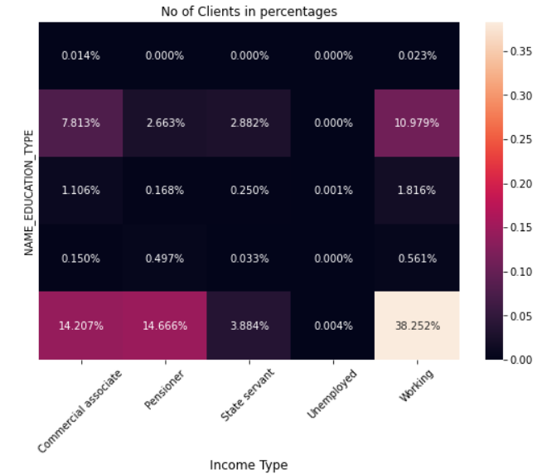
Education Type w.r.t Income Type
38% of our clients are from Working class who are Secondary/ Secondary special graduates but they have a high risk of 10.5%.
We have a slightly lower number of clients of Pensioner class who are Secondary/ Secondary special graduates at 14.6% but their default rate is very low at just 5.58%.
Similarly for Working clients with Higher education and Commercial Associate with Secondary Education, they have a lower default rate as compared to Working class with Secondary Education.

Slide 28
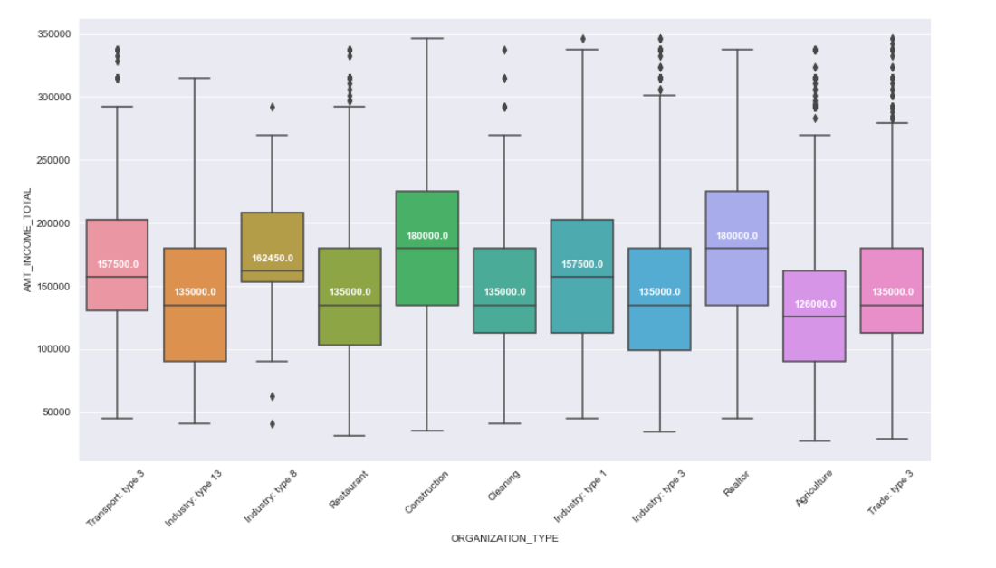
Distribution of Income of Top Organization type defaulters
Medians are below or around 1,50,000.

Slide 29
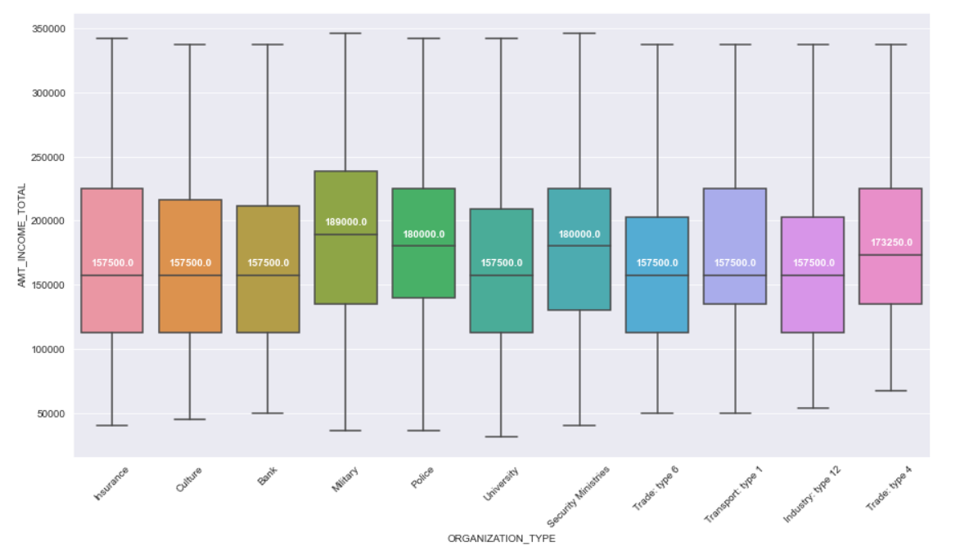
Distribution of Income of Lowest Organization type defaulters
The Clients from organization type with highest defaulters have a lower income average of 1,57,509 as compared to 1,74,427 income average of clients from organization type of lowest defaulters with a difference of 17,000 between them.

Slide 30
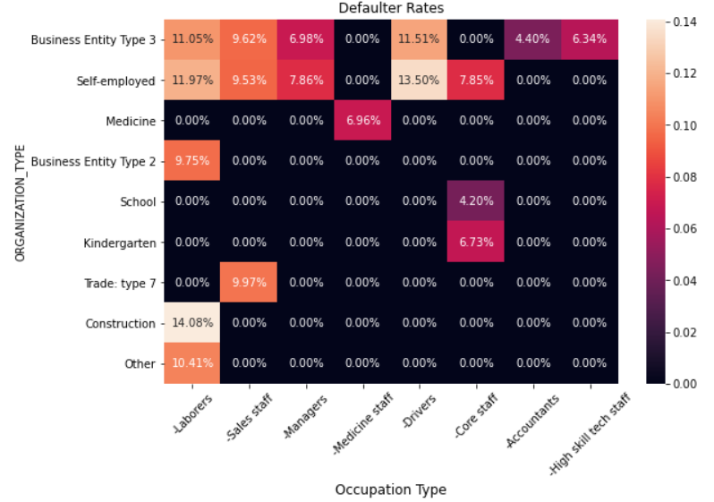
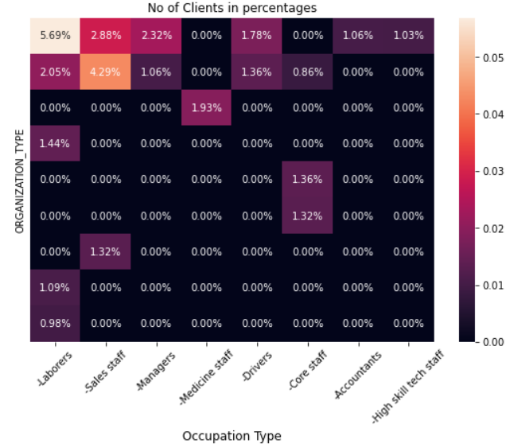
Organization Type w.r.t Occupation Type
- 5.7% of our Clients are Laborers from Business Entity type 3 and they have the highest defaulter rate at 11%.
Followed by Sales Staff who are Self Employed or are from Business Entity type 3 who are also in higher numbers (4.3% and 2.9%) and also have a high defaulter rate at 9.5% and 9.6% respectively.
So we should focus less on these types of clients and change our collection strategies for the same.

Slide 31
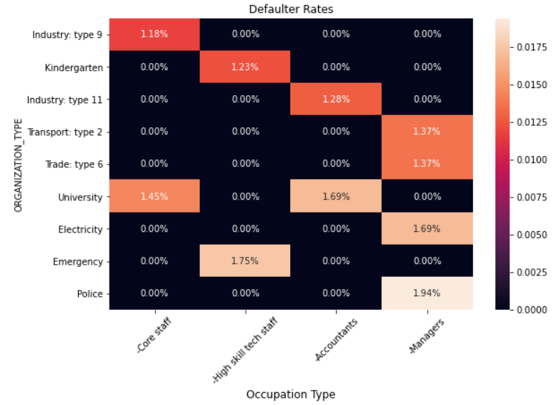
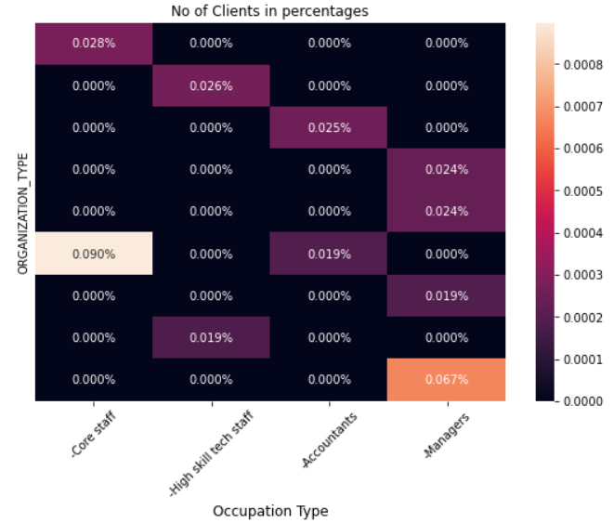
Organization Type w.r.t Occupation Type for Low Defaulter Rate Types
Core Staff from Industry type 9 have the lowest defaulter rate at 1.176% followed by High Skill Tech Staff from Kindergarten and Accountants from Industry type 11 at 1.235% and 1.282% respectively followed by Managers from Transport type2 at 1.370%
But all of these top 10 combined only contribute to 0.34% of the total Clients.
So we should focus on bringing more clients from these organizations and occupations.

Slide 32
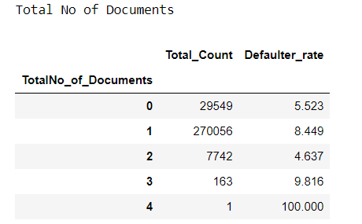
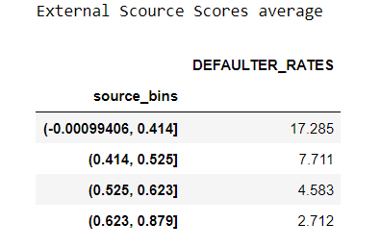
NEW Columns Created
No of Previous Application
Total No of Documents Submitted
External Source Score Average
There are a total of 20 Documents

